Slide 1
PROJECT - Build a Suggestion Box App By Dhruv Sevak
Basically there are 5 main module of the App:
Create an App
Add Custom Fields
Modify the User Experience
Add Business Logic
Create Reports and Dashboards

Slide 2
1.Create an App
Create a Salesforce app that includes standard collaboration and analytics features.
The app’s user interface.
OBJECTIVE:
You build a suggestion management app that allows employees to submit suggestions and track
their status using these steps:
1. Create the app definition and a data model for the application. This simple application
requires only one custom object.
2. Modify the user interface on the browser and on the Salesforce mobile app using page
layouts, compact layouts, and global actions.
3. Automate calculations, data quality, and database updates to improve the user
experience using formulas, validation rules, and a process builder.
4. Define reports, charts, and dashboards to track the status of suggestions and analyze
how well the company manages suggestions.

Slide 3
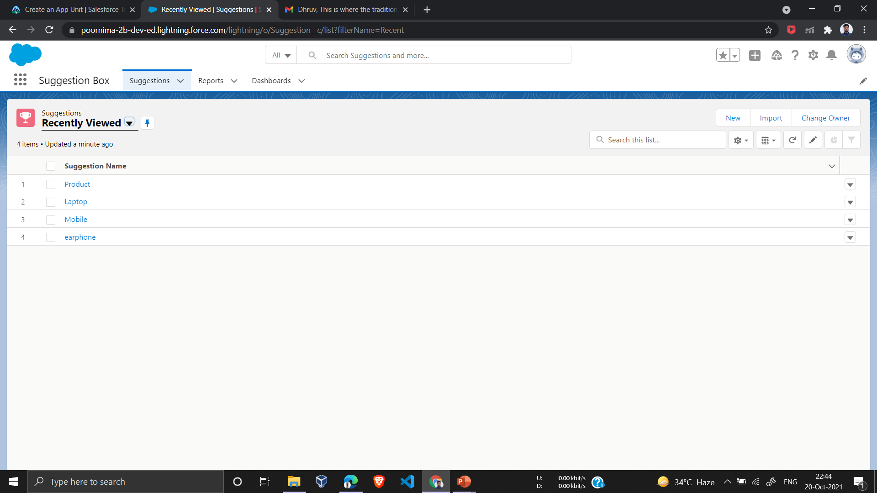
Create an App and a Custom Object In this firstly we create Custom Object , Custom Object Tabs, New Lighting App
App Launcher—Displays available apps.
App name—Displays the current selected app.
Navigation menu—Displays the tabs available inside the app.

Slide 4
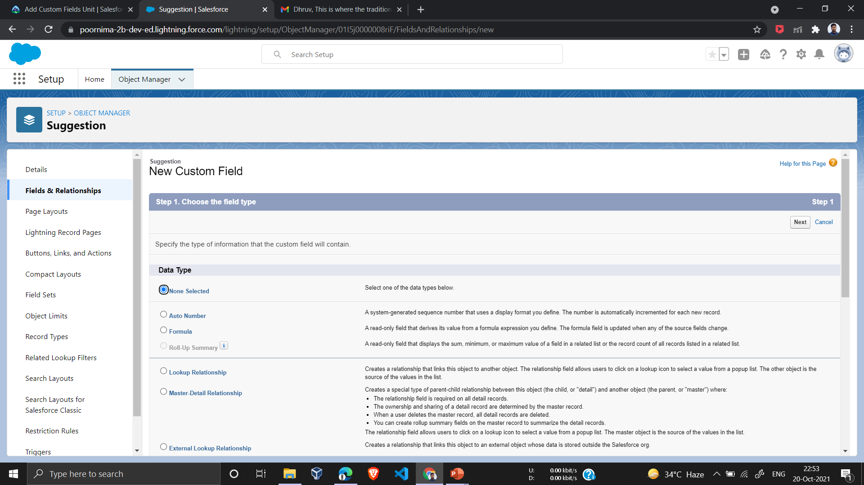
2.Add Custom Fields By default, custom object has some standard fields on it. We just need to add more fields to store relevant information about each suggestion. Fields can store many types of data.
Add a Description Field
This field is used by employees when they explain their suggestion.
Add a Category Field
This field helps us categorize each suggestion. It also makes it easier for us to report on what types of suggestions we get the most.

Slide 5
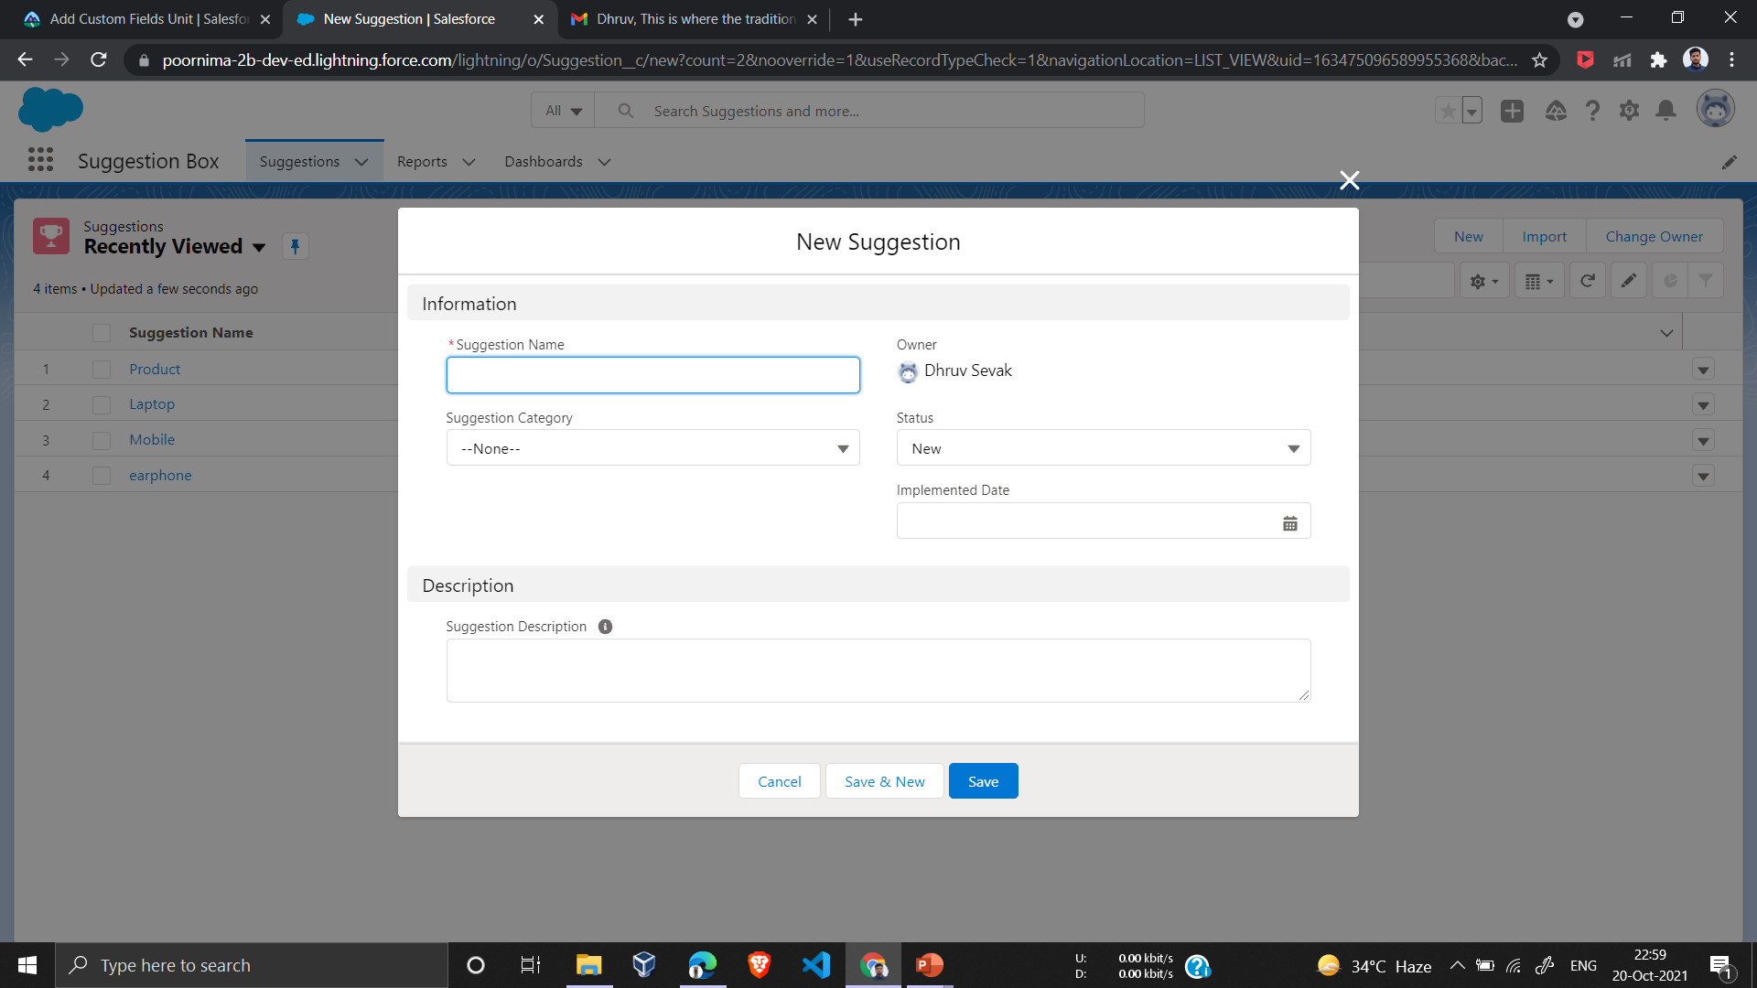
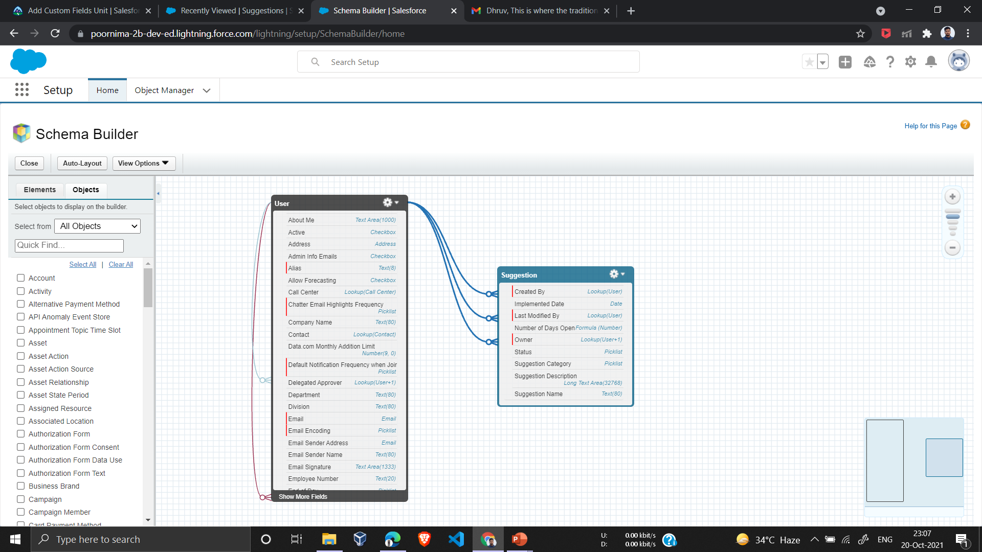
Suggestion Category Data Type - Text Area (Long) Suggestion Description Data Type - Picklist
Viewing Objects in Schema Builder
Schema Builder provides a dynamic environment to add new custom objects, custom fields, and relationships to your Salesforce database.
In the Schema Builder i add Suggestion Object and User Object.

Slide 6
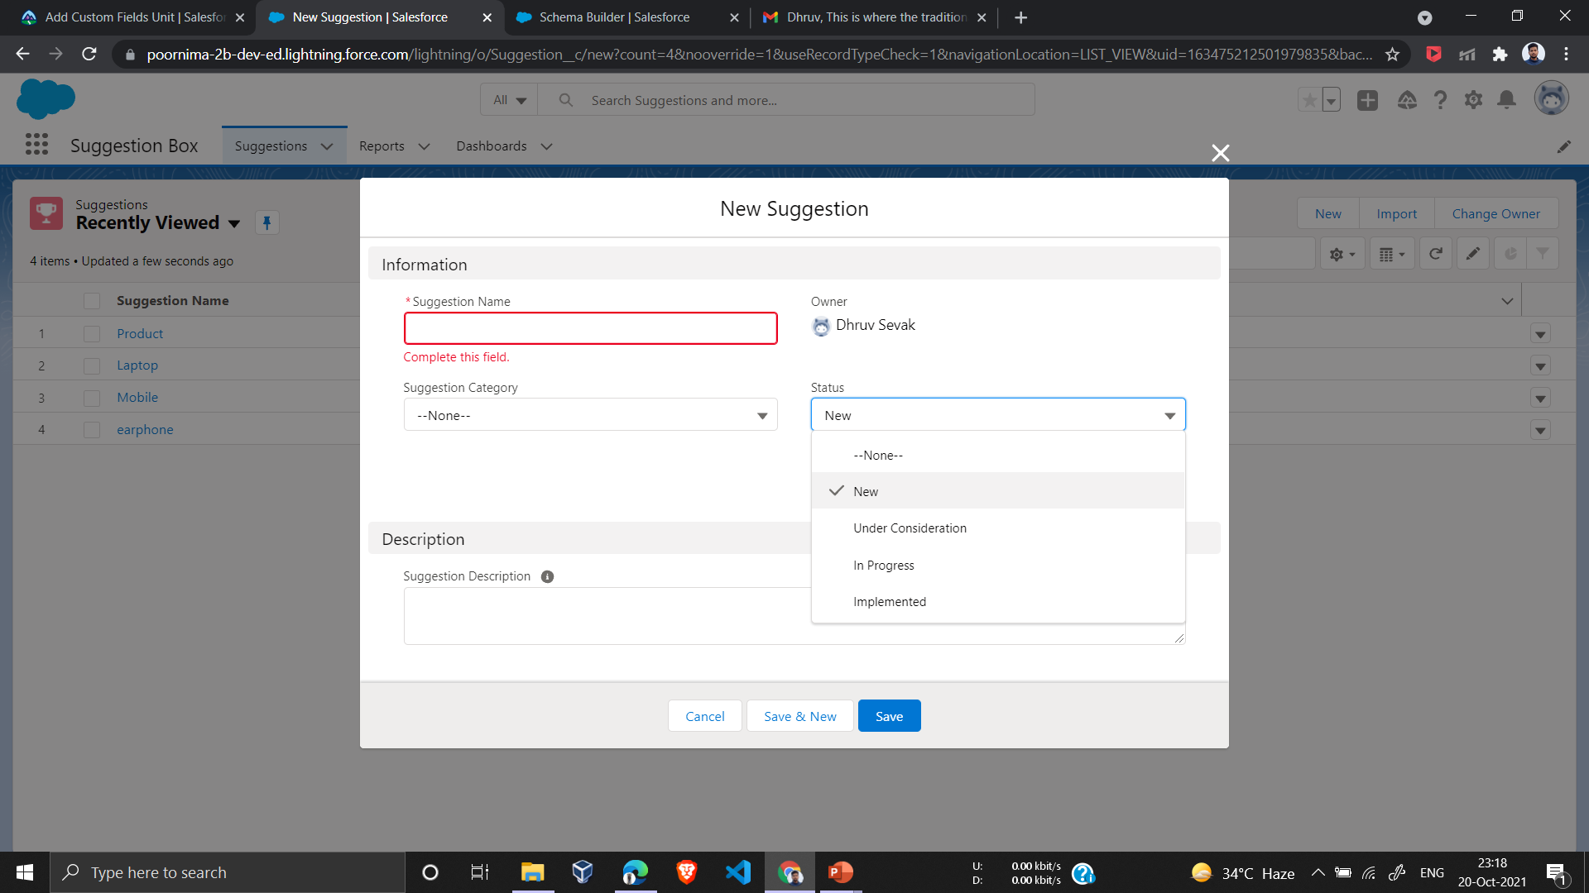
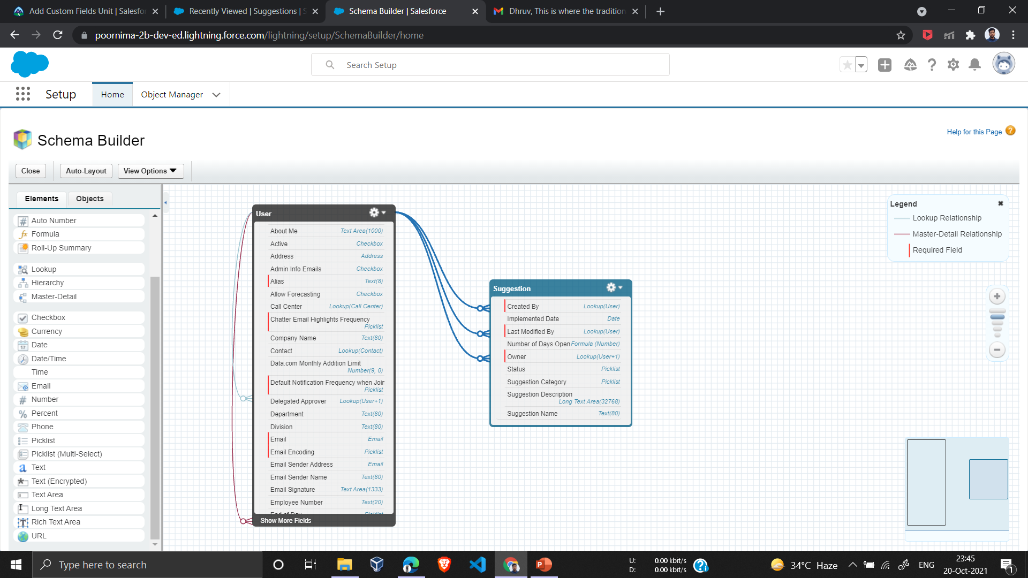
Add a Status Field This field helps track the status of the suggestion. It is also a way for the suggestor to know what is going on with their suggestion. This field will have unique security protocols in that only admins can change the status. Elements tab.
Add a Status Field
This field helps track the status of the suggestion. It is also a way for the suggestor to know what is going on with their suggestion
Add a Date Field
This field helps track when the Suggestion was Implemented. It’s also important because we reference this field in the formula field we create in a later exercise.

Slide 7
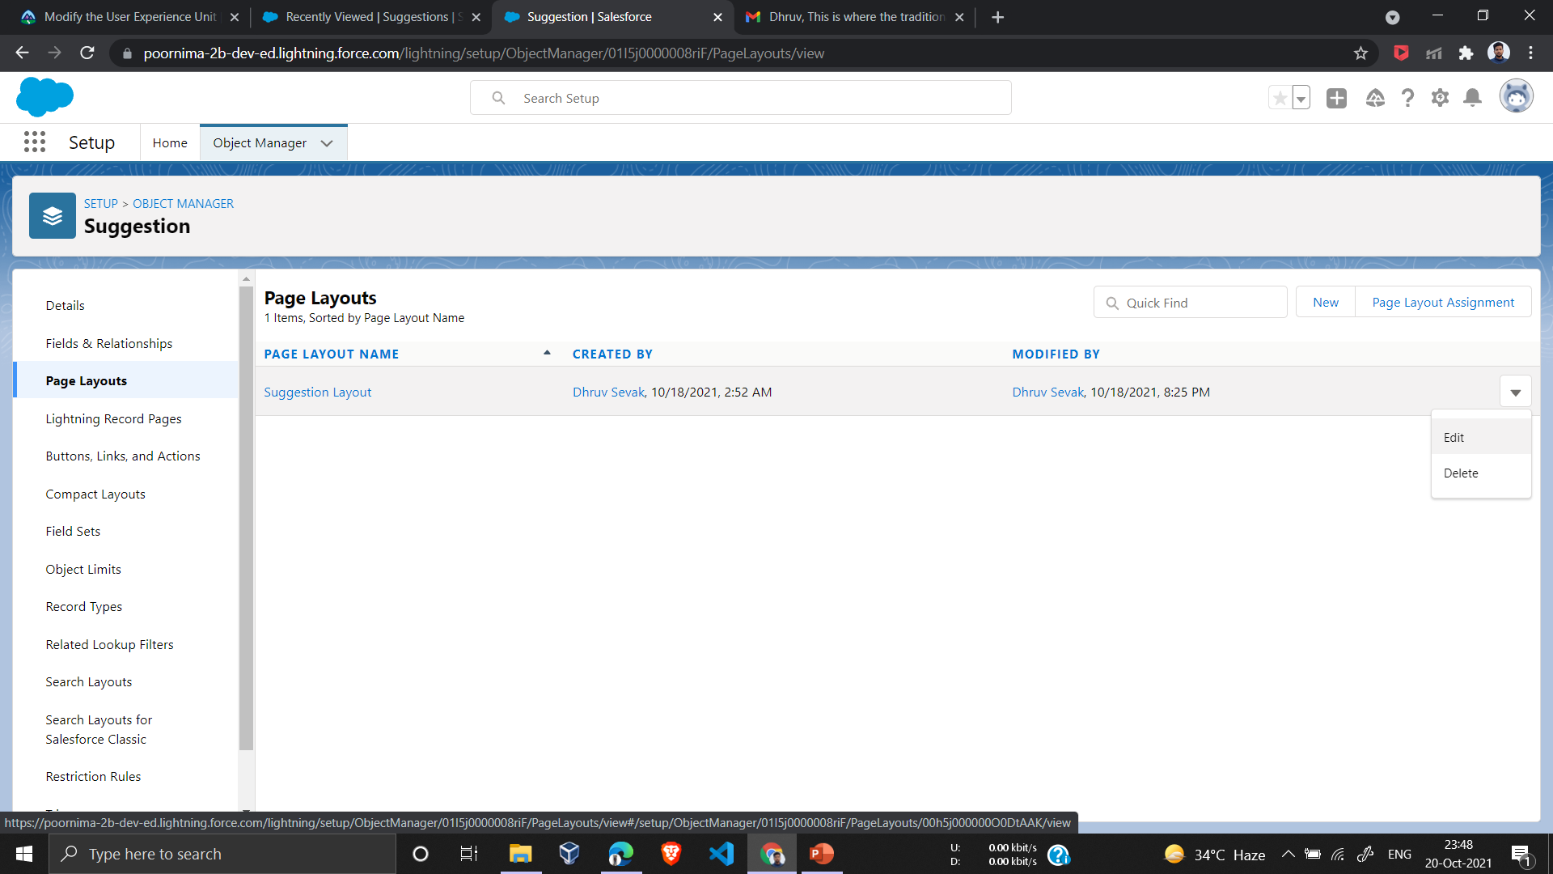
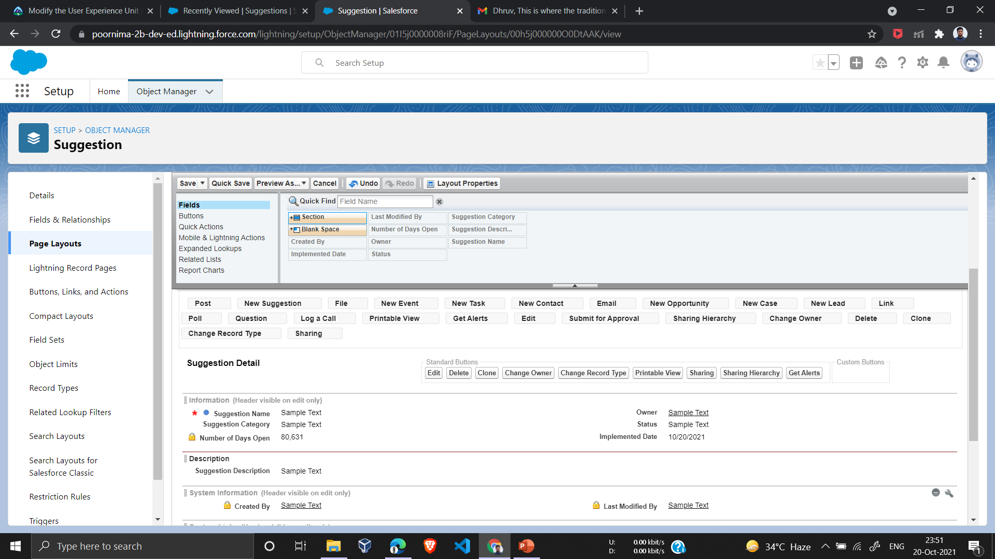
3.Modify the User Experience Changing the UI for the browser pages involves modifying the Suggestion object's page layout. Add a Global Action to make it easy for employees to add suggestions wherever they are in the Salesforce app.
Modify the Page Layout
Now add a new Description section and rearrange the remaining fields.

Slide 8
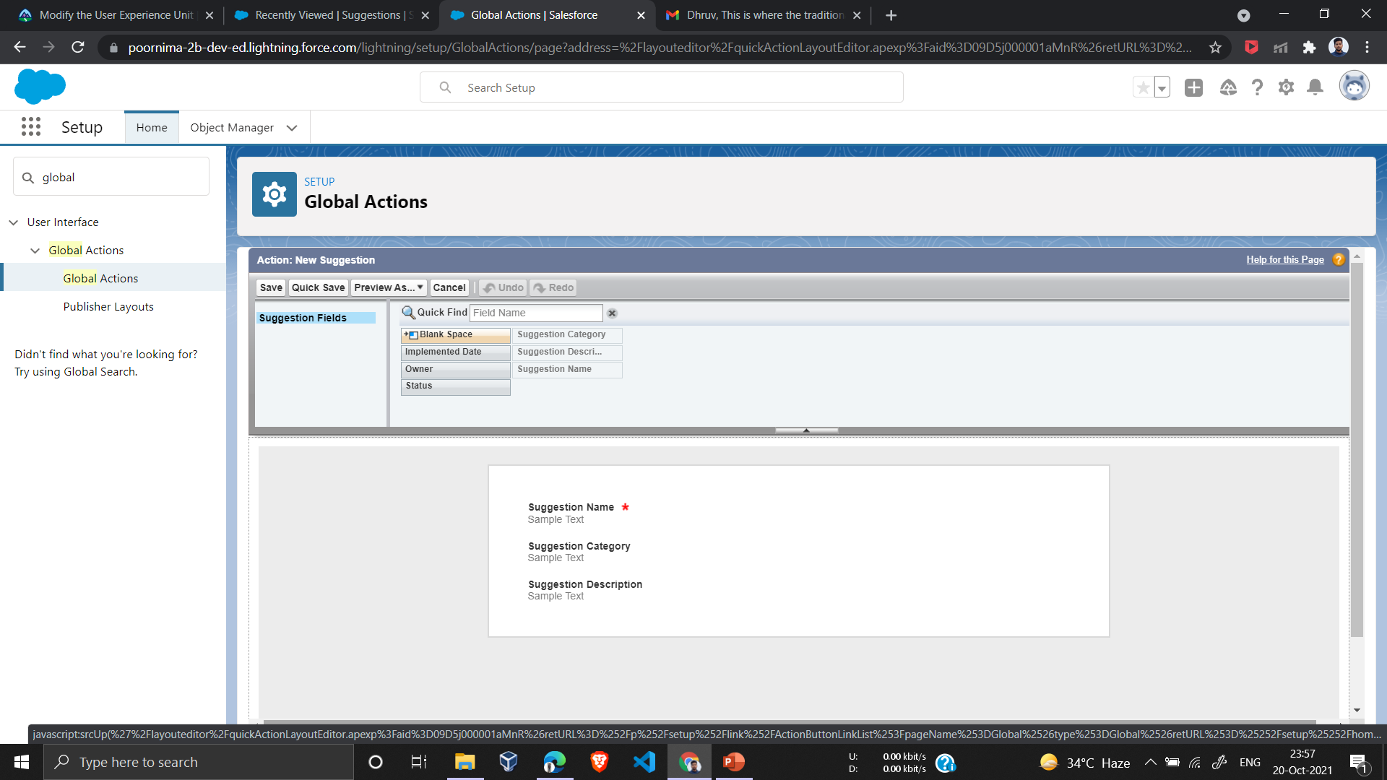
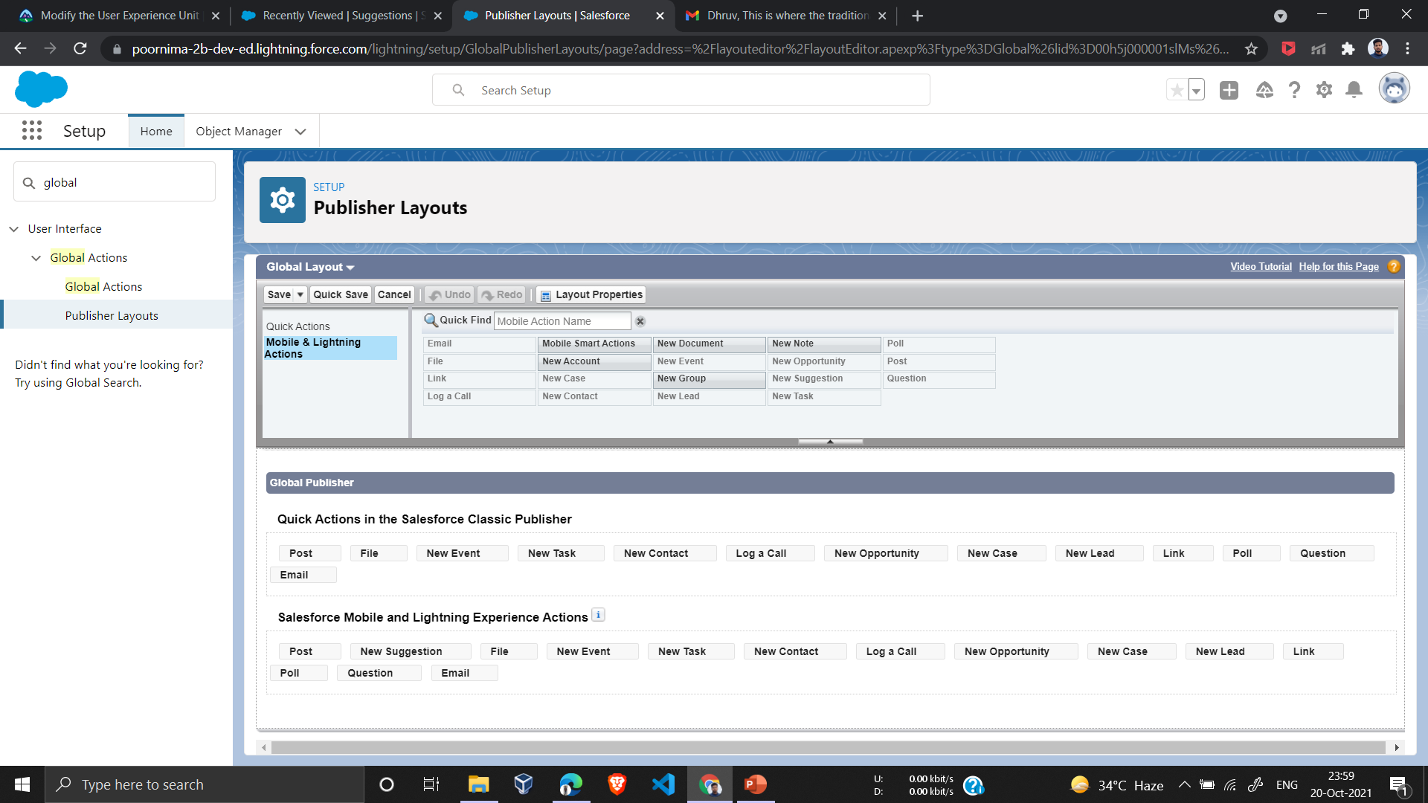
Add a Global Action Things are looking pretty good, but from talking to employees about how they work, we’ve found that they think of suggestions while they’re doing other tasks and don’t want to leave what they are doing to submit a suggestion.
I created a new action, but users can’t see it yet. Let's fix that next
Through Publisher Layouts in Global Action

Slide 9
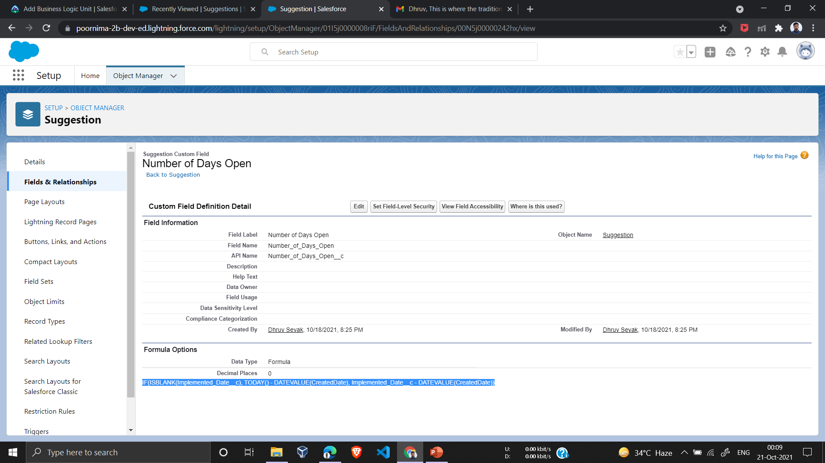
4. Add Business Logic So Far , App lets employees securely enter and view data about suggestions. That’s pretty cool, but let’s make the platform work a little harder for us so that our users don’t have to.
Add a Formula Field
A formula field derives its value from other fields, expressions, or values, saving your users a lot of time. Let’s add a formula field to calculate the number of days from suggestion creation to implementation.
Data type - Formula

Slide 10
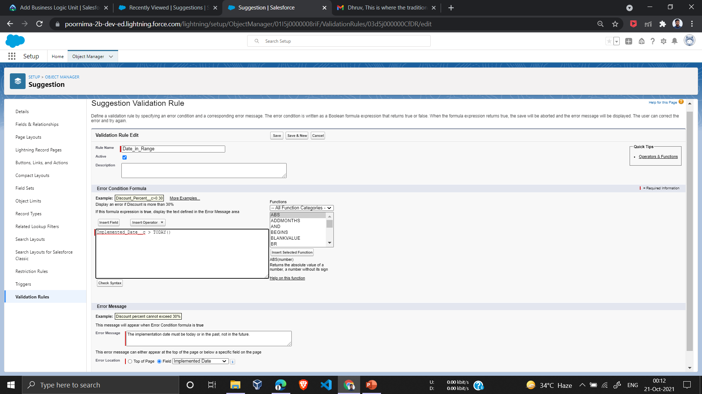
Add a Validation Rule Formulas are also used to ensure data quality and enforce business rules. Our employees cannot predict the future, so let’s create a validation rule to make sure that they don’t enter implementation dates that haven’t happened yet. With validation rules, you define the condition for “bad” data. When the system evaluates the rule, it blocks the user from saving the data if the condition is true.

Slide 11
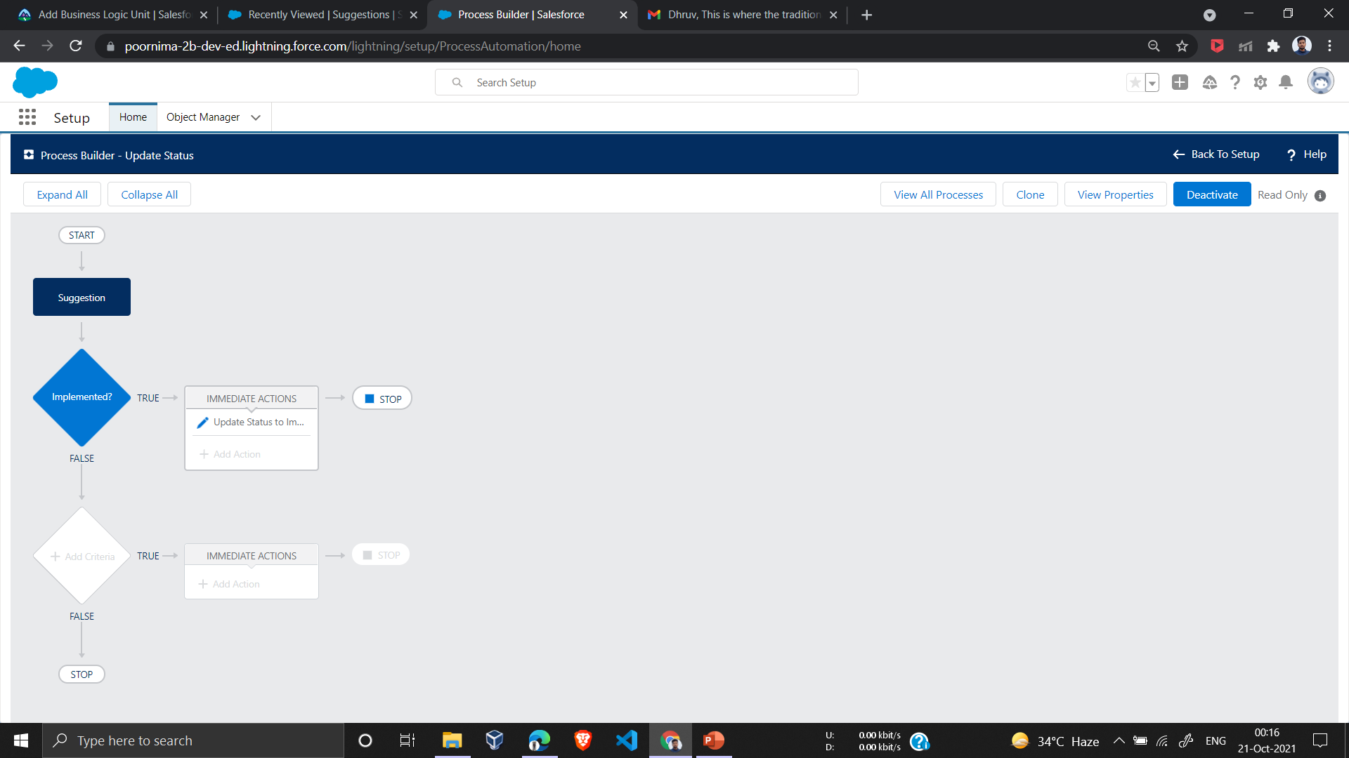
Add a Field Update Using Process Builder Formulas are also useful when automating business processes. When a user adds an implemented date, let’s update the status automatically to Implemented.
After this Step the Implemented Date drop down validation will come in action in suggestion.

Slide 12
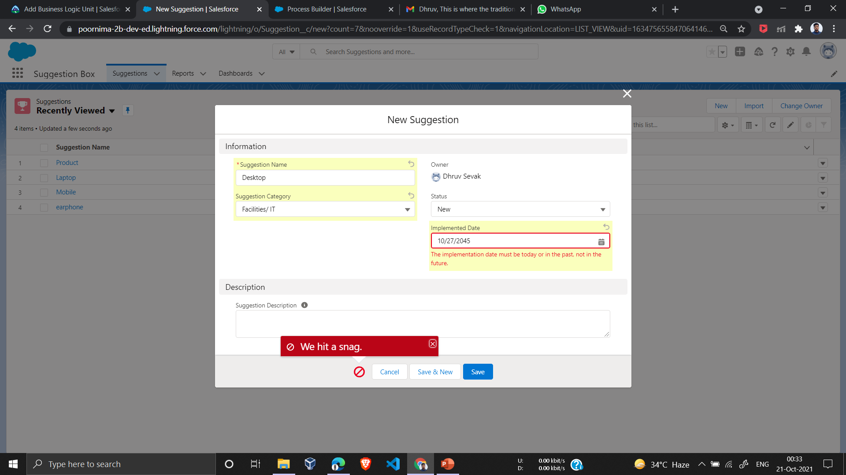

Slide 13
5.Create Reports and Dashboards The Suggestion Box app I created includes a Reports tab and a Dashboards tab, where i can create, edit, and run reports and dashboards. These features make an app more useful by providing the business with valuable insights
Tabular Reports
Tabular Reports are the most simple type of Salesforce Report. They show your data in rows and are most effective when your goal is to export it. Tabular Reports shouldn’t be used when you want to manipulate data in any way like present totals, calculations, or groups of data.
Matrix Reports
Matrix Reports are a step more complicated than Tabular Reports where they can show data in rows and columns. They can be used to see different totals from your data and are effective when your goal is to display a huge amount of complex data.
Summary Reports
Summary Reports in Salesforce are the most commonly used reports and are designed to show groups of data. With summary reports, you can group data by different accounts, and then do calculations to see totals, maximums, minimums, and averages.

Slide 14
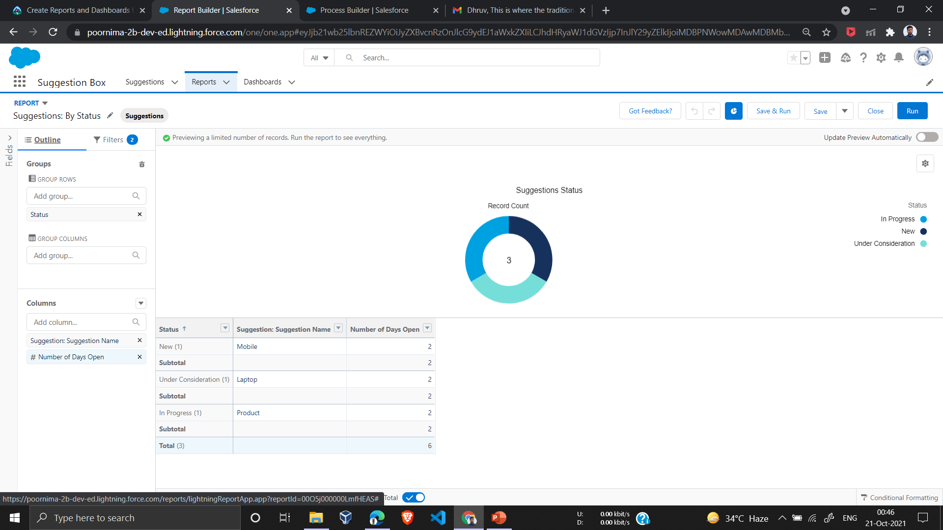
Create a Summary Report and a Report Chart It’s often a good idea to give users a visual way to understand the data in your report. Tabular reports don’t include charts

Slide 15
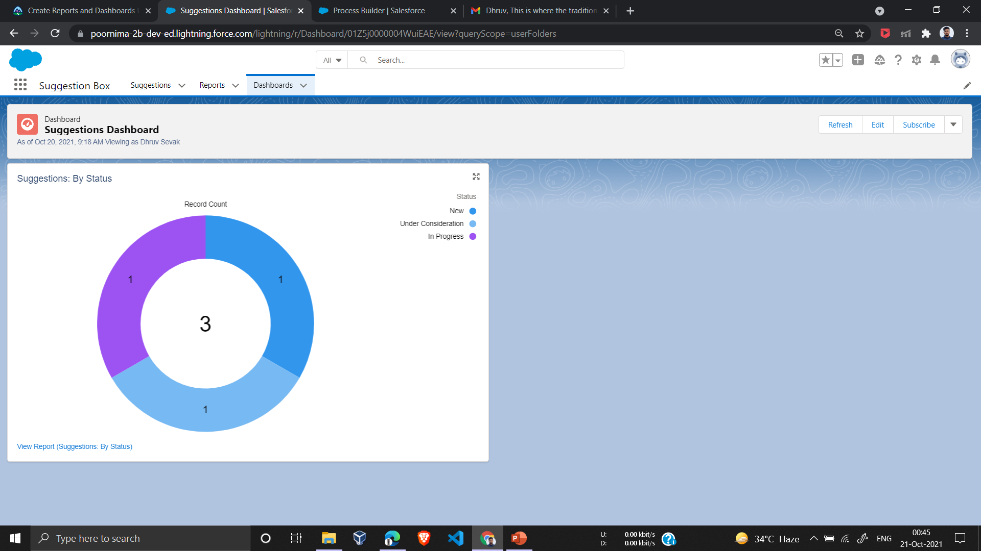
Create a Dashboard Dashboards in Salesforce are like a dashboard in your car, showing you important information at a glance. Dashboards can show data in charts, gauges, tables, and metrics. Dashboards are powered by reports.

Slide 16
Conclusion
In the end I would like to conclude that all the above mentioned data were covered in detail and I was able to make this project based upon the learning.

Slide 17
Thank You

